Slide 1







Central
Team ScriptExchange
Ng Yong Jie
Jiang Lei
Bryan Lim Kai Wen
Anand Chaanan Singh
Notes:
Hi we are Team ScriptExchange
We would like to introduce our application: PSACentral

Slide 2
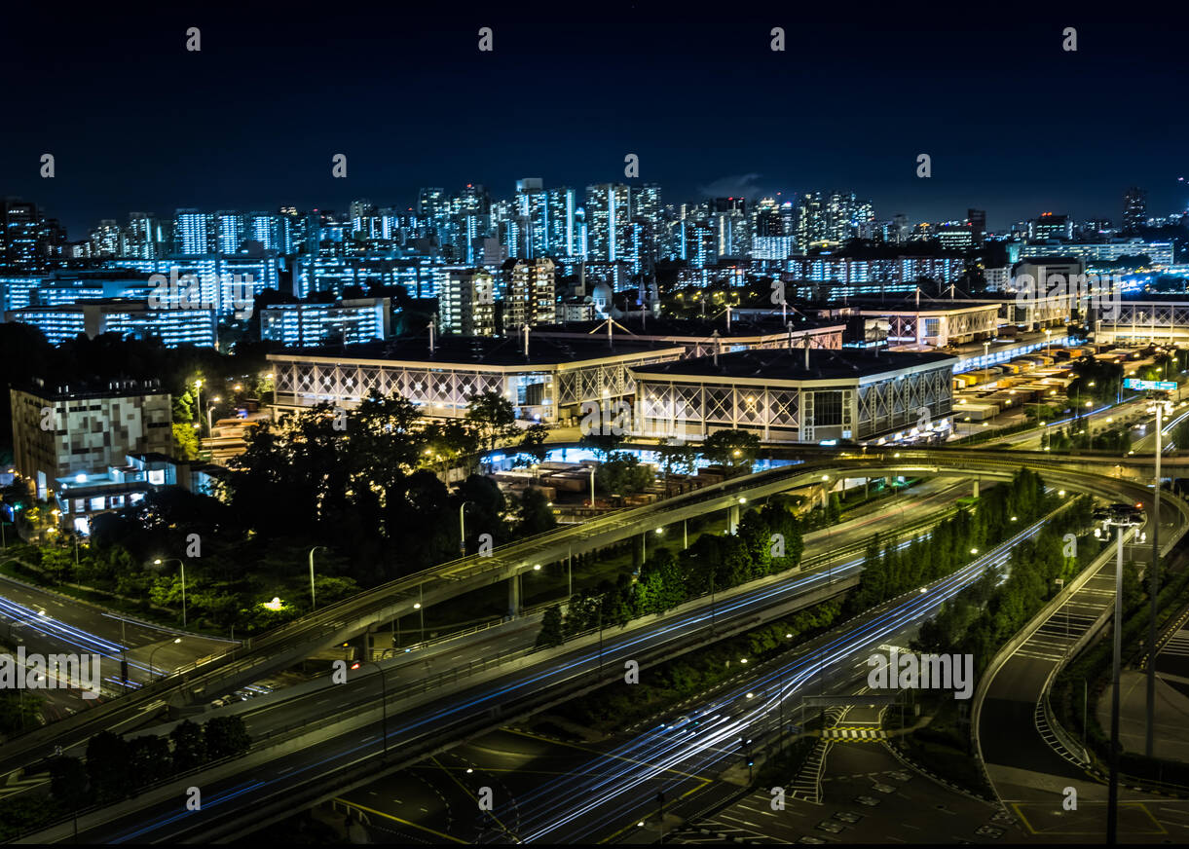


Executive Summary:
Our Winning Strategy to help into the KD Community
Problems
Solution
Target Audience
PSA is currently just acting as a commercial landlord
PSACentral
A community platform to enhance operation synergies and generate revenue from Container Freight Stations
Targeting:
KD Community
Companies looking to utilize Keppel Distripark
There is an untapped opportunity to build a community of tenants at Keppel Distripark (KD)
Key Features
Resource Exchange
Service Platform
Freight Market
Tapping on to an untapped market to boost PSA Revenues
Notes:
Here’s our executive summary of our approach to PSACentral

Slide 3



The Problem (PS1): PSA needs to go beyond being a commercial landlord by providing services that could benefit the KD community and generating revenue in the process
Opportunities
Broker
for sharing of physical resources such as warehouse space, handling equipment, trailers and pallets.
Master Service Provider
of services including supply of labour for container unstuffing /stuffing, trucking, storage, railing, permit documentations, etc.
Cargo Marketplace
For cargo consolidators and freight forwarders to buy or sell excess cargo space for various trade lanes
Who benefits?
Keppel Distripark (KD) Tenants benefit through increased operation synergies
PSA benefits through increased revenue streams
Companies looking to utilize Keppel Distripark for storage
Sources: SMU, MAS, MOE, Quark
Notes:
For the PSACodeSprint, we have chosen to tackle the problem statement one under the SUPPLY CHAIN DIGITALIZATION & DECARBONIZATION
problem statement theme.
Problem Statement One is about PSA needing to go go beyond being a commercial landlord by providing services that could benefit the KD community and generating revenue in the process
Here are the services that PSA can provide to the KD community.
Firstly, KD can act as a broker for sharing of physical resources such as warehouse space, handling equipment, trailers and pallets.
Secondly, as a Master Service Provider of services including supply of labour for container unstuffing /stuffing, trucking, storage, railing, permit documentations, etc.
Lastly, as a Cargo Marketplace for cargo consolidators and freight forwarders to buy or sell excess cargo space for various trade lanes
Now who benefits from this beyond the KD tenants.
Well, PSA benefits throught increased revenue streams and the Companies looking to utilize Keppel Distripark for storage also benefit

Slide 4


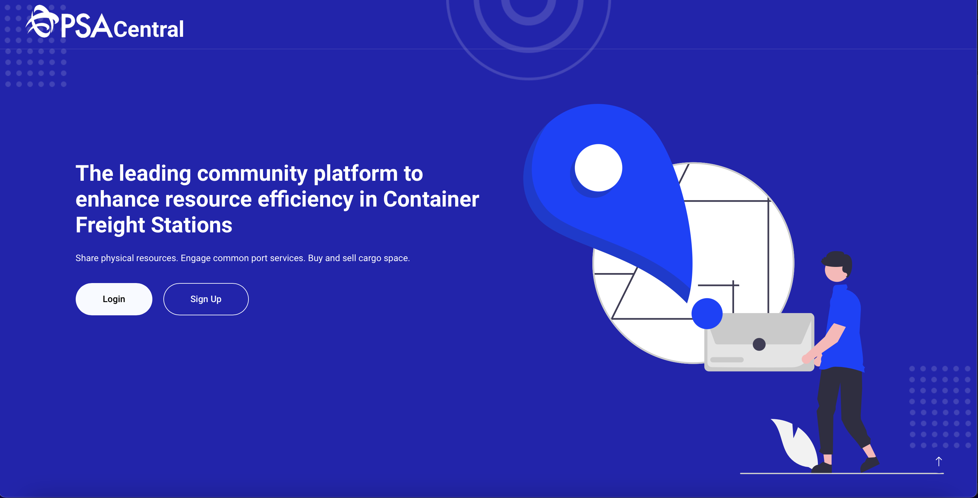
Our Proposed Solution: PSACentral
A community platform to enhance operation synergies and generate revenue from Container Freight Stations
Key Benefits
One Stop Solution
Extensible platform
Operation synergies
Supply Chain Digitalization
Improve efficiency
Minimize human-error
Automation
Boost Revenue
- Multiple services to generate additional revenue
Notes:
Through PSACentral ,we introduce a community platform to enhance operation synergies and generate revenue from container Freight Stations
The whole platform functions as a One Stop Solution for Port Users and can be extended beyond the KD community as well. It also allows operation synergies between the 22 tenants at KD and PSA, allowing for increased economies of scale
Another benefit would be Supply Chain Digitalization as everything is now on a one stop solution and potential users do not now need to resort to phone calls and manual paper work for certain activities at ports.
Lastly, PSA stands to boost revenue by offering this service and can potentially sell the platform to other port operators around the world.

Slide 5
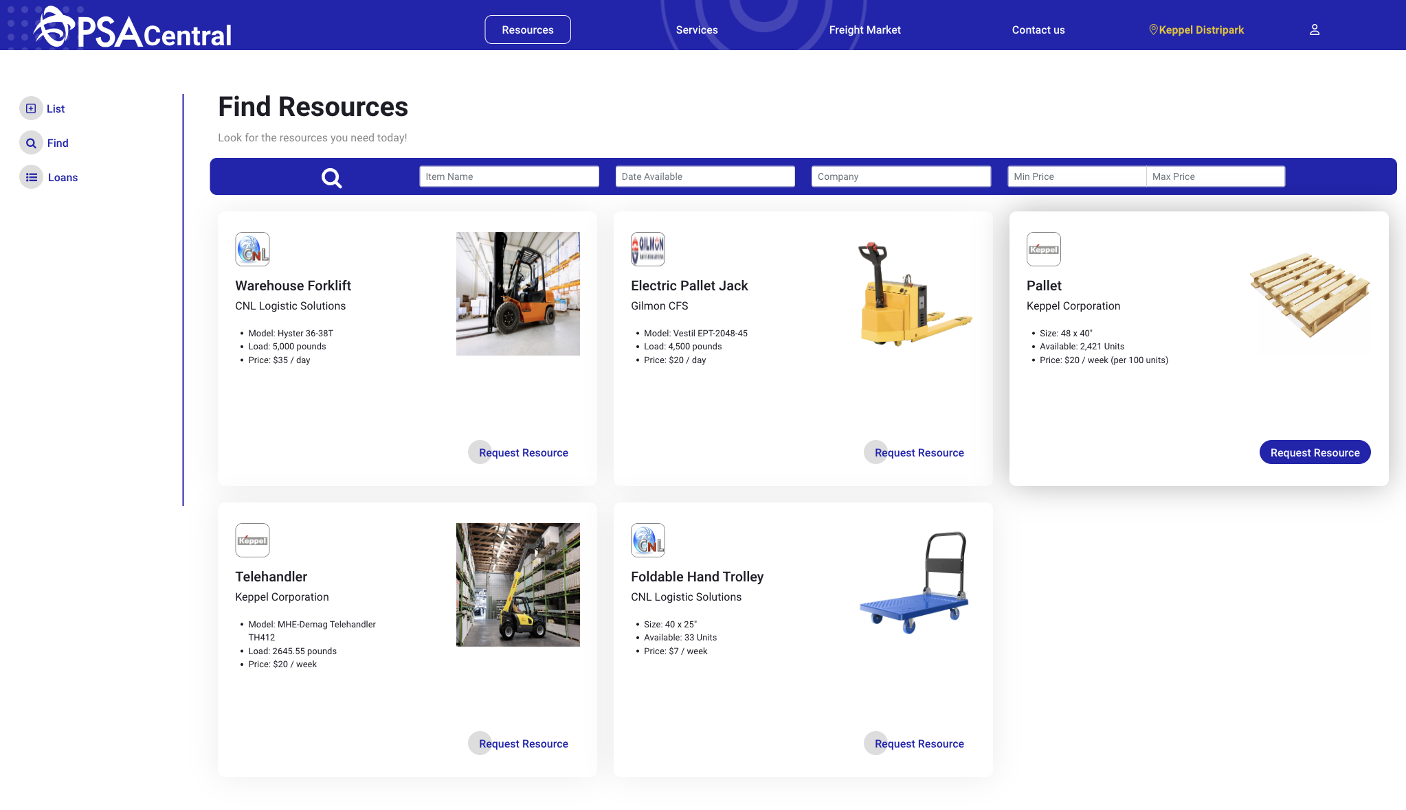



Resource Exchange: Sharing of physical resources between KD tenants to boost operation synergies
For Users
List
List items on the exchange by filling up an intuitive listing form
Find
Find items you need and reserve them using an elegant calendar interface
Manage Loans
View items that you have loaned out or are currently loaning from other tenants
Notes:
One of the key features PSACentral provides is a resource exchange platform. On this platform KD tenants may list equipment or resources that they have for a given time period. Subsequently, other tenants would be able to see the listed resources and request for the ones that match their requirements. Finally, they may proceed to the loans page to manage all their listed resources as well as resources they are receiving from other parties.

Slide 6
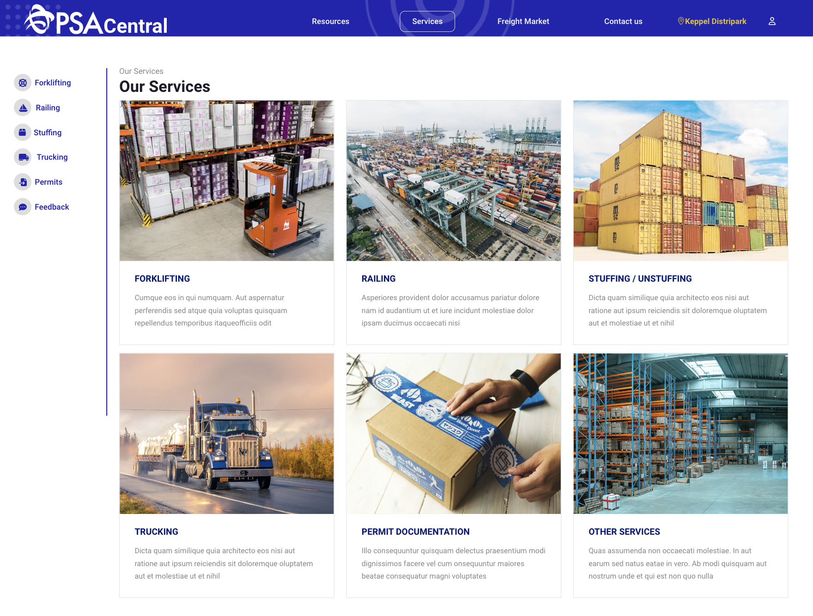
Service Platform: Easy access to services provided by PSA to KD tenants
Key Features
Key Features
Forklifting
Rent available forklifts based on daily or weekly charges
4
Trucking
Request for trucking services by filling out a simple form
Railing
Request for railing services provided by PSA
5
Permit Documentation
Upload completed forms for swift approval from authorities
Stuffing/Unstuffing
Request for stuffing/unstuffing by filling out a simple form
6
More to come
Notes:
Another key feature of PSA Central is the service platform. The service platform lists a wide range of services that PSA can provide to tenants. This includes forklifting, railing, stuffing/unstuffing, trucking and permit approval services. To access these services users simply need to navigate an intuitive user interface and fill out the various forms based on their needs. Subsequently they will receive email confirmation of the the services they have requested for.

Slide 7
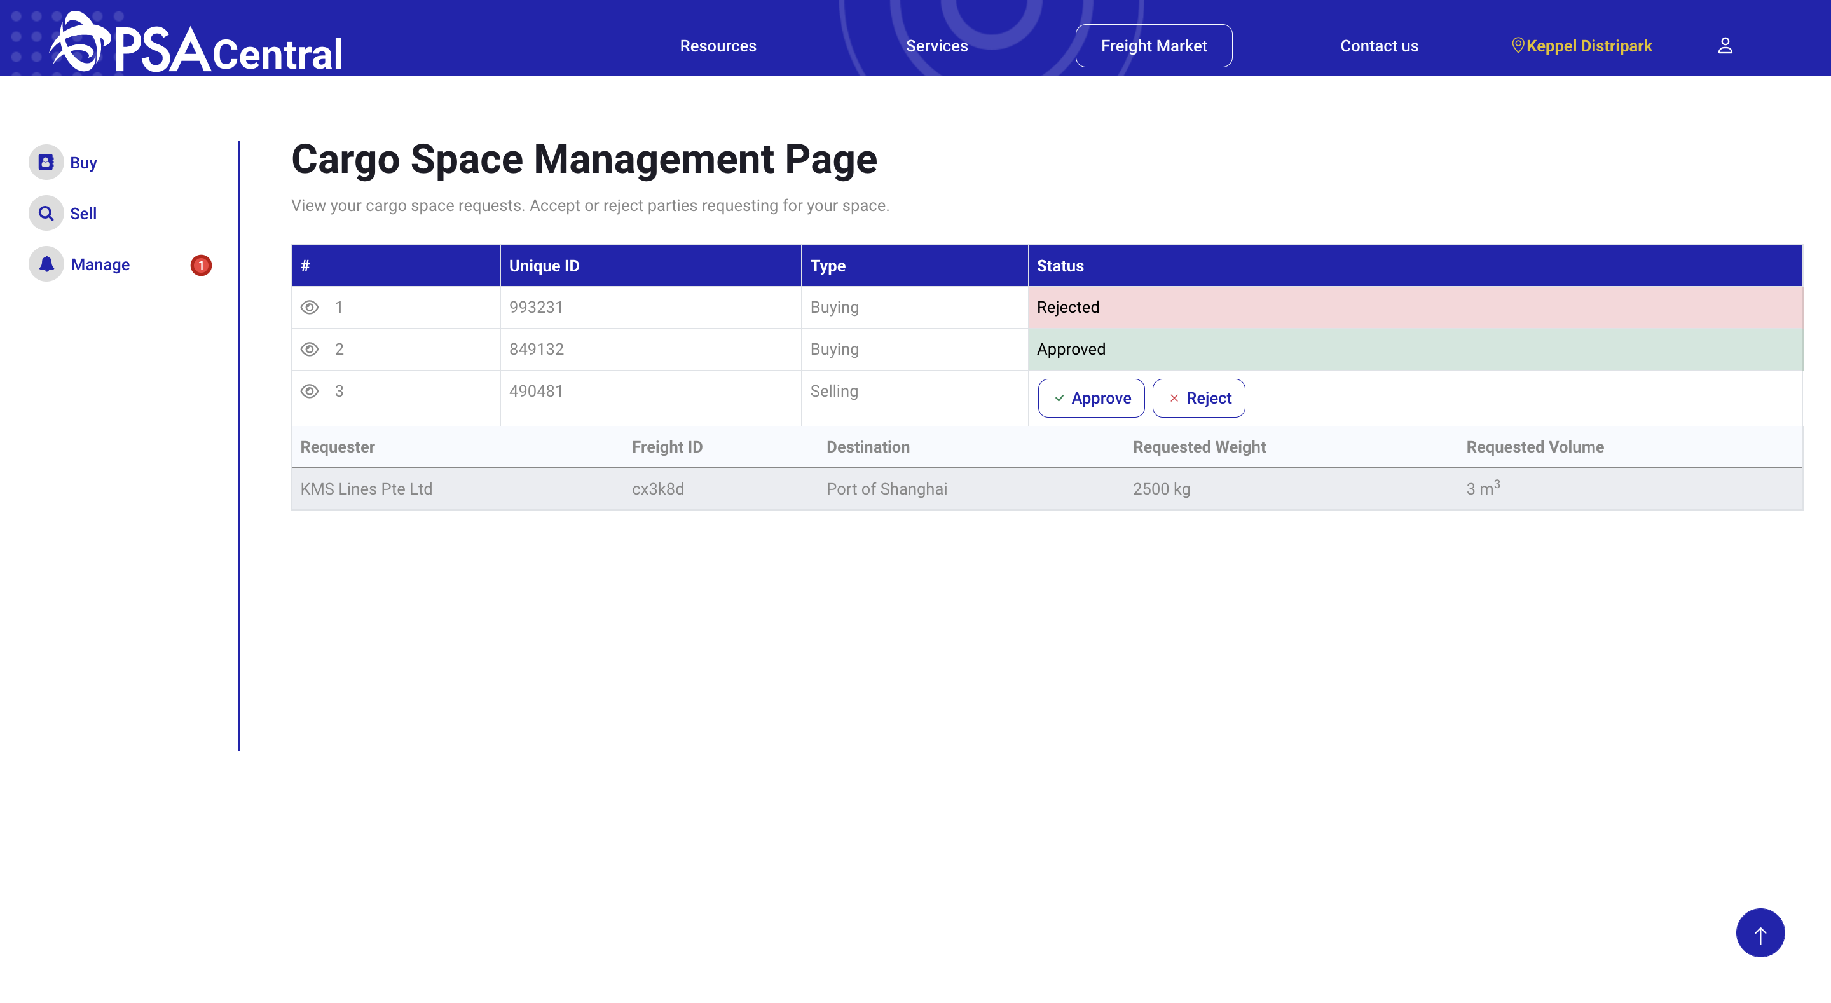
Freight Market: Online exchange for cargo space
For Users
Buy
Find cargo space that meets your requirements and send a request to the provider to use the space.
Sell
Fill the form out to list your available cargo space on the market.
Manage
You will be able to see all buy /sell requests under the manage page.
Notes:
Finally, PSA Central provides a freight marketplace for cargo consolidators and freight forwarders to sell or buy cargo space on various trade lanes. The sell page allows for listing of cargo space and the buy page allows users to request space for space from providers. Lastly, the manage page allows for a quick overview of the cargo space that you have requested or other parties are requesting from you.

Slide 8
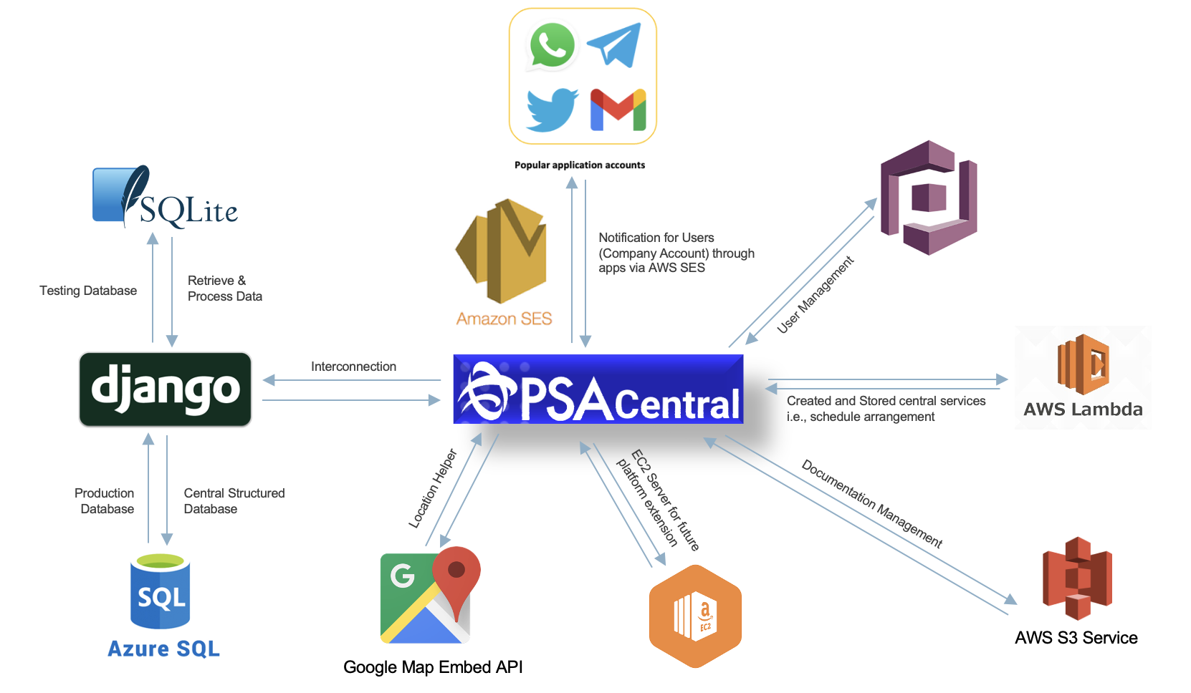
PSACentral TechStack
Notes:
In order to implement this platform we leverage on various cloud technologies to ensure, low costs while maintaining scalability. Our application runs on EC2 allowing us to leverage various auto-scaling features, furthermore we employ amazon SES to provide notifications to our users through commonly used communication platforms. User access and roles are managed via Amazon cognito and AWS lamda is used to implement various features such as schedule arrangement. Amazon S3 provides convenient file storage for managing the large amounts of documents that our application expects to receive. Finally we leverage on Azure SQL to store meet our applications’ data needs.

Slide 9
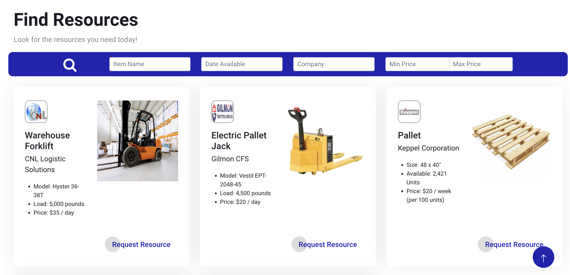

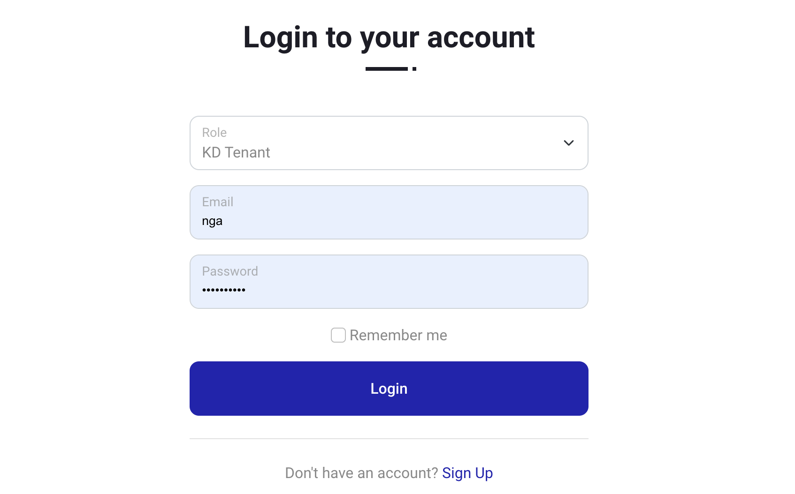
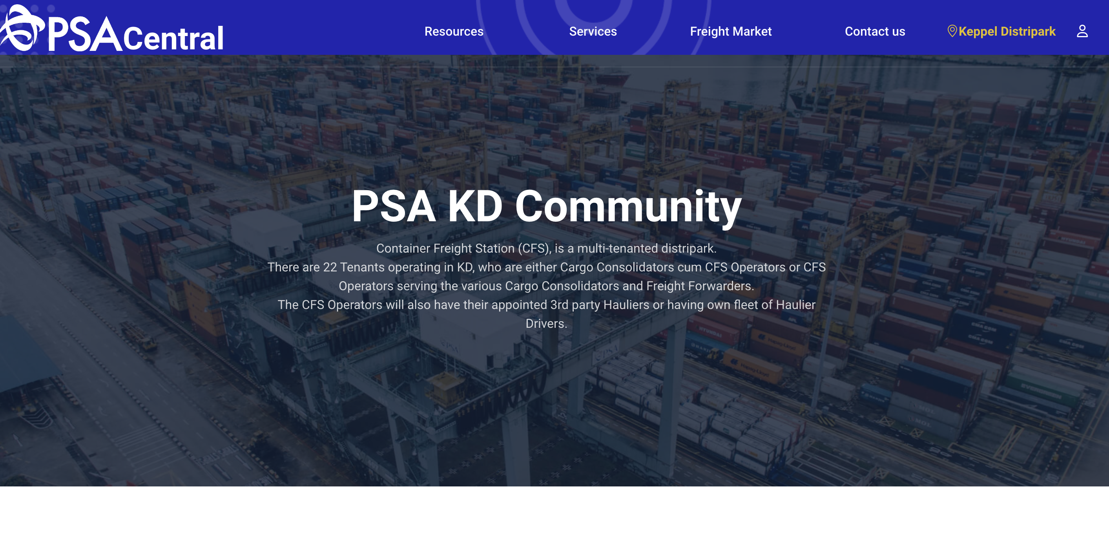
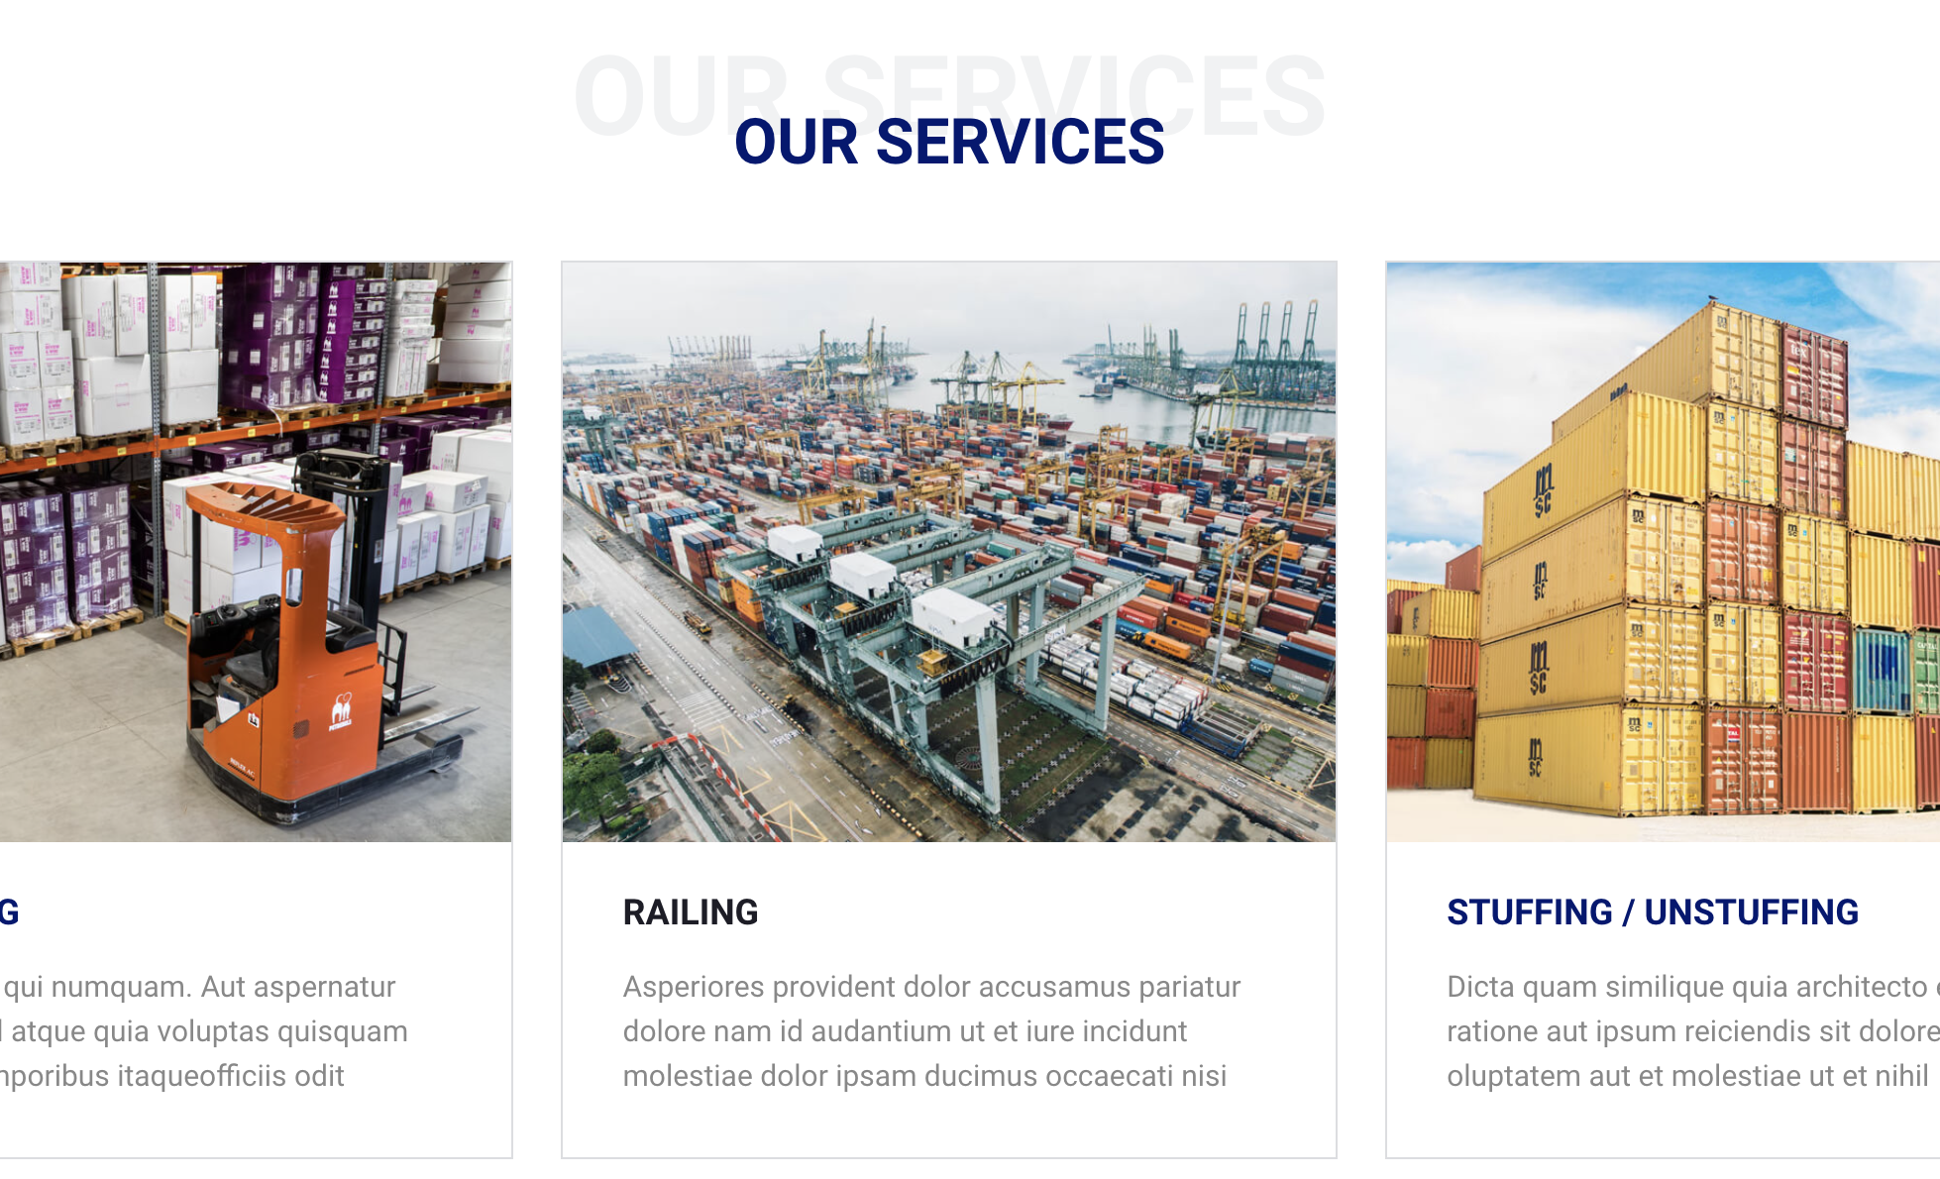
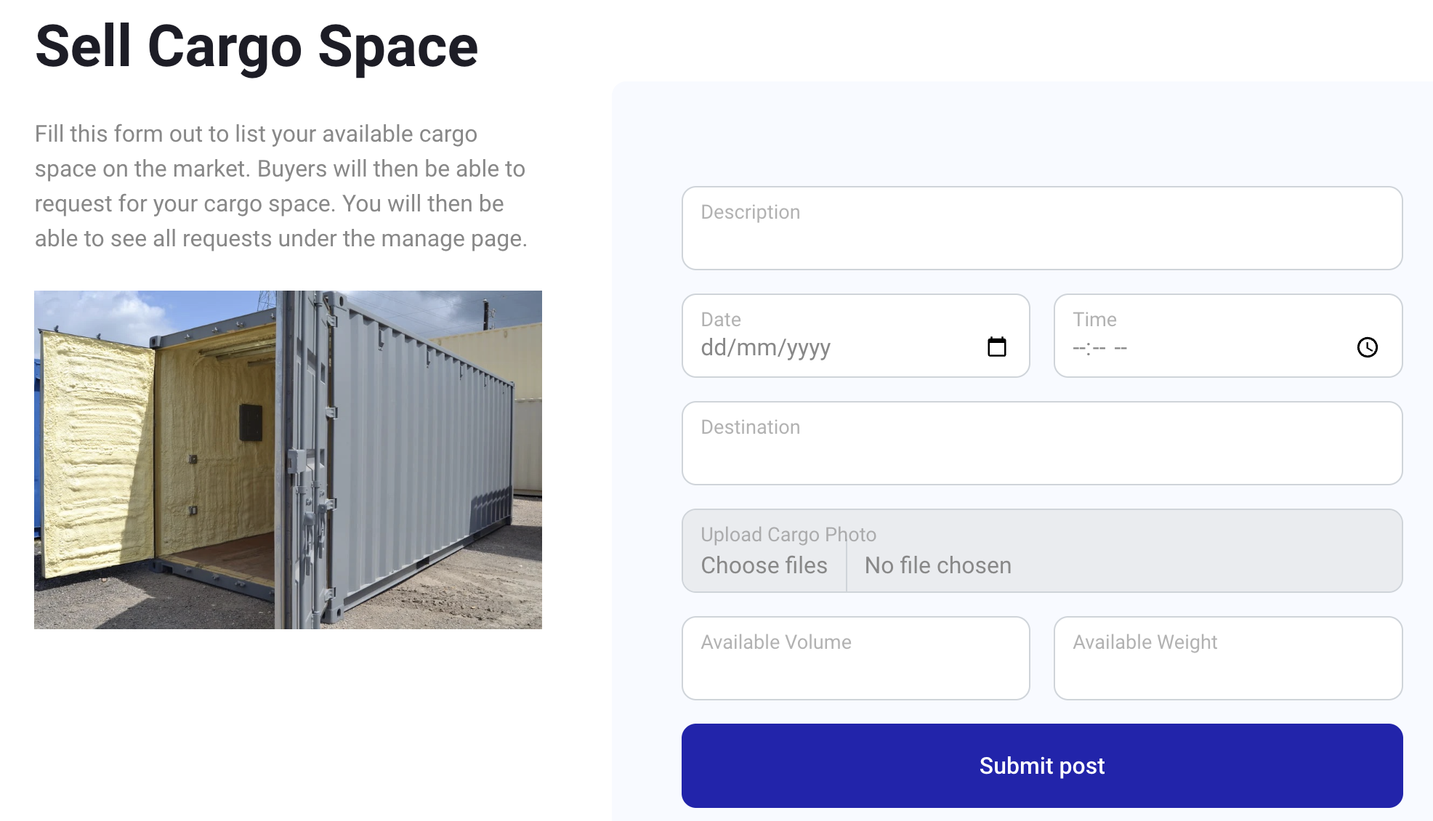
Value Propositions: Through a user journey, we can see the clear benefits that PSACentral holds for tenants
John can find equipment/resources he requires
John Doe, 30
Worker at a Freight Forwarder
Looking for a one-stop platform for port services
Comfortable with technology
John can enlist PSA for common port services
John hears about the cool features on PSACentral from his friends and logs on
From the portal, John finds 3 types of services available to him
John can find the freight space he needs
Having seen the services provided by PSACentral, John looks forward to using the portal for his company in the future

Slide 10





Beyond our “MVP"
Expand Platform Services to Other Parks
Forums
Include Online Chat
Suggest More Services
Management Portal
For PSA Admin
Have multi-language support
Notes:
Our PSA service is extensible and scalable; it can be expanded to other parks in addition to KD Park. In the future, our platform can include online chat tools and PSA can facilitate more services and expand business channels. At the same time, the admin management portal will be built up to facilitate user management, resource allocation, etc. Such an expansion will be powered by a multi-language system.

Slide 11





Roadmap of PSA Central
Development
Collaboration
Marketing
Development
Prototyping & Testing
Release MVP
Pilot Launch in Reservist Units
Evaluation
Phase
Local release
International release
Connecting database
User Validation
Collaboration
Us right now
Marketing
Outreach to KD Tenants & Provision of User Training
Notes:
To end it off, here is our proposed roadmap for implementation of PSA Central!
We would break it down into three components, which are development, collaboration and marketing. This is to ensure that we set clear goals at each stage, and can dedicate the required resources and attention.
Right now, we are here at the start of the first phase
For the first phase, we would be doing prototype and testing for the web service while connecting our database with PSA.
Phase 2 will see us release an updated MVP and continue to get user validation before pilot launching it.
Along the way, starting from the end of phase 1, we would concurrently carry out marketing campaigns on various social media platforms on Instagram and Facebook to spread the PSA Central Service name.
Lastly, the final phase would see us doing a local release and internal release for all PSA ports and parks.

Slide 12

Thank You
With special thanks to:
Notes:
Hi we are Team ScriptExchange
We would like to introduce our application: PSACentral

Slide 13
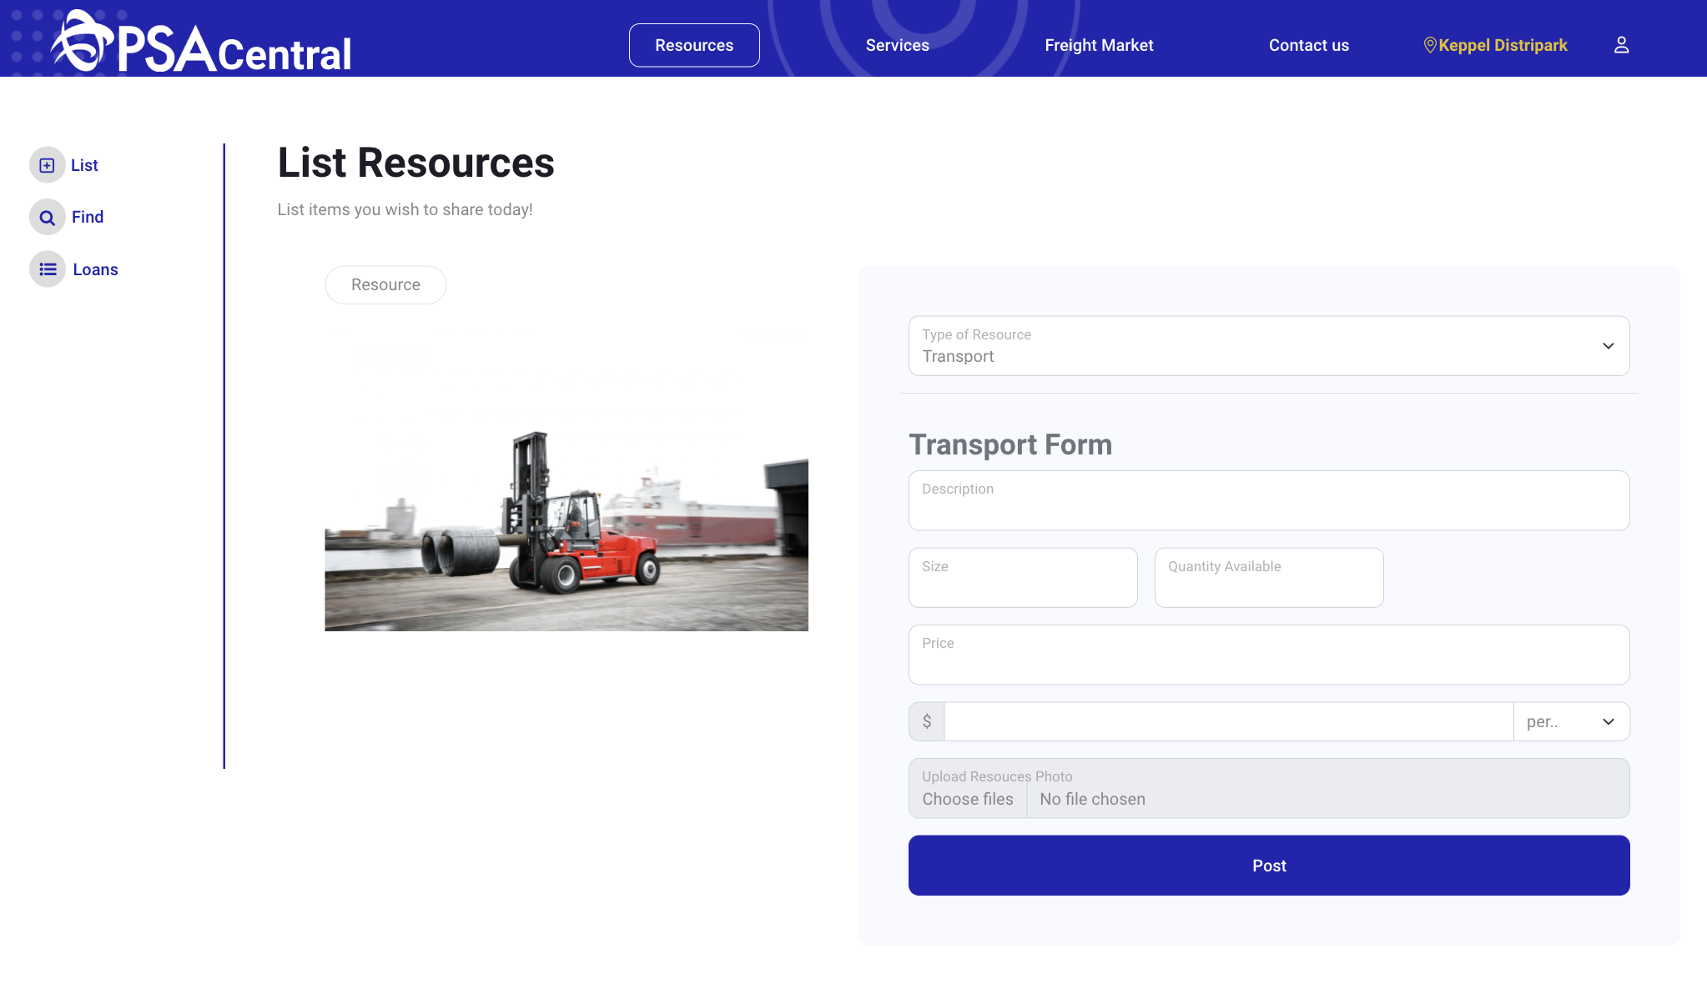
Appendix A: Resources Pages
List
Notes:
FEATURE - SERVICES

Slide 14
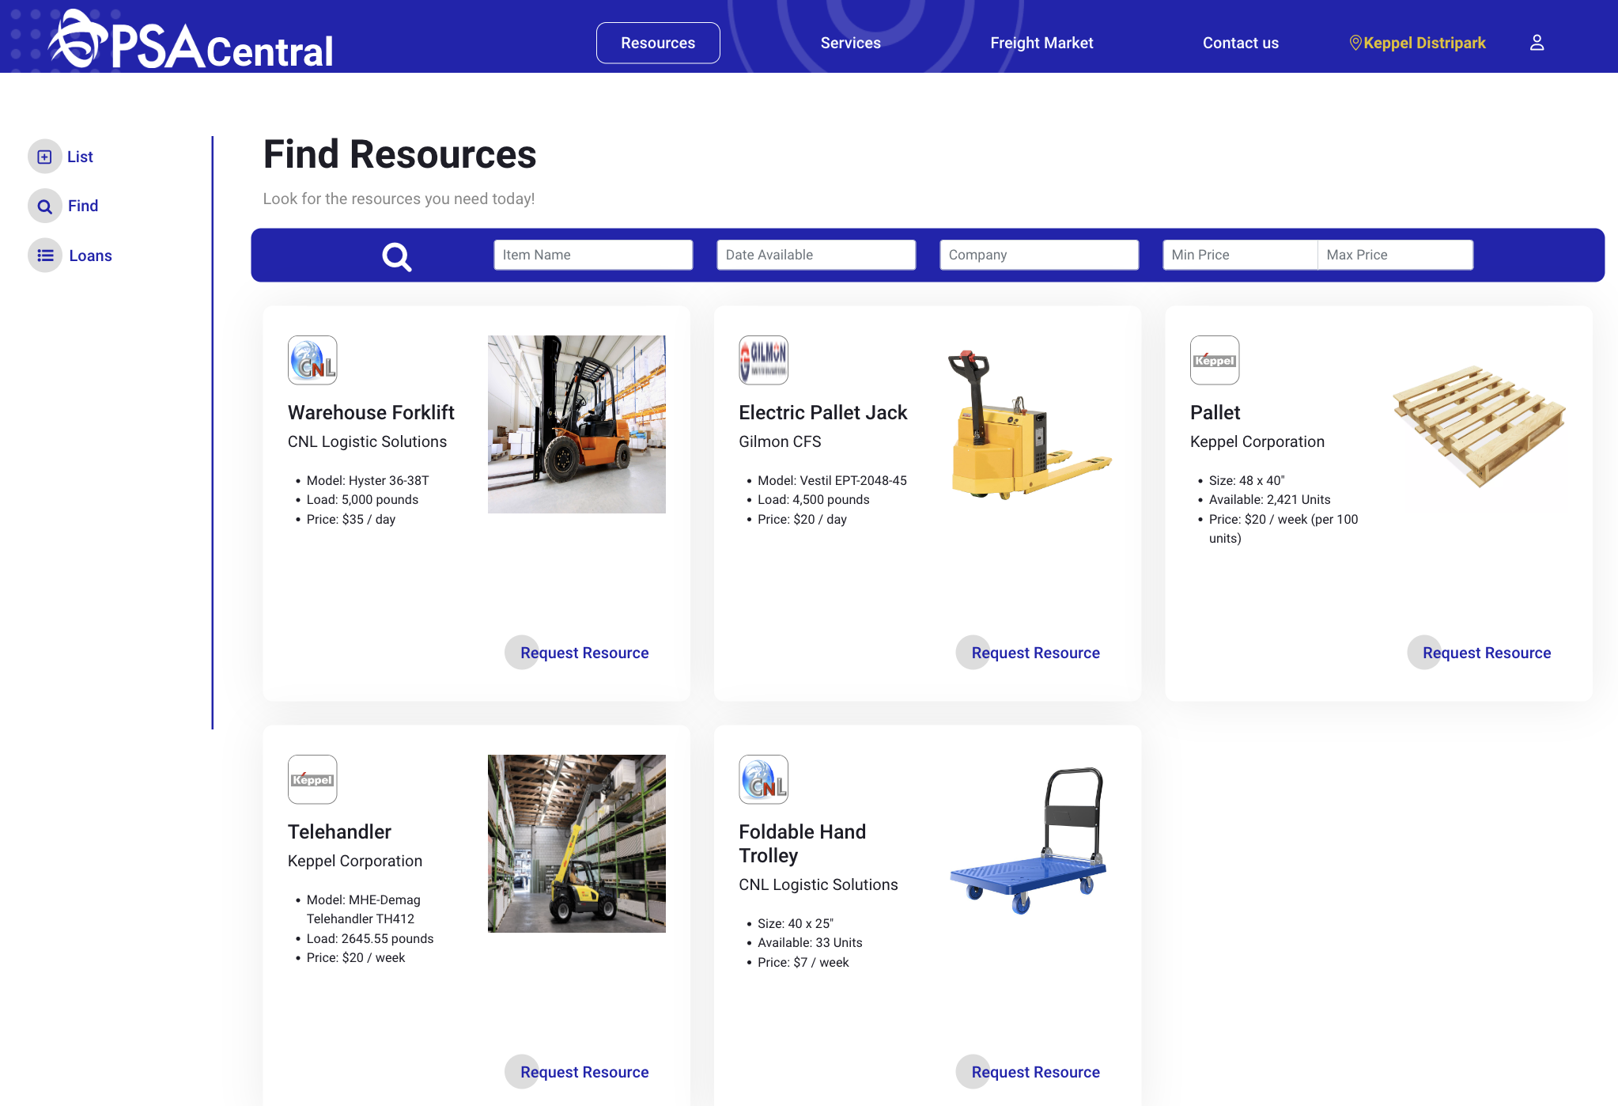
Appendix A: Resources Pages
Find
Notes:
FEATURE - SERVICES

Slide 15
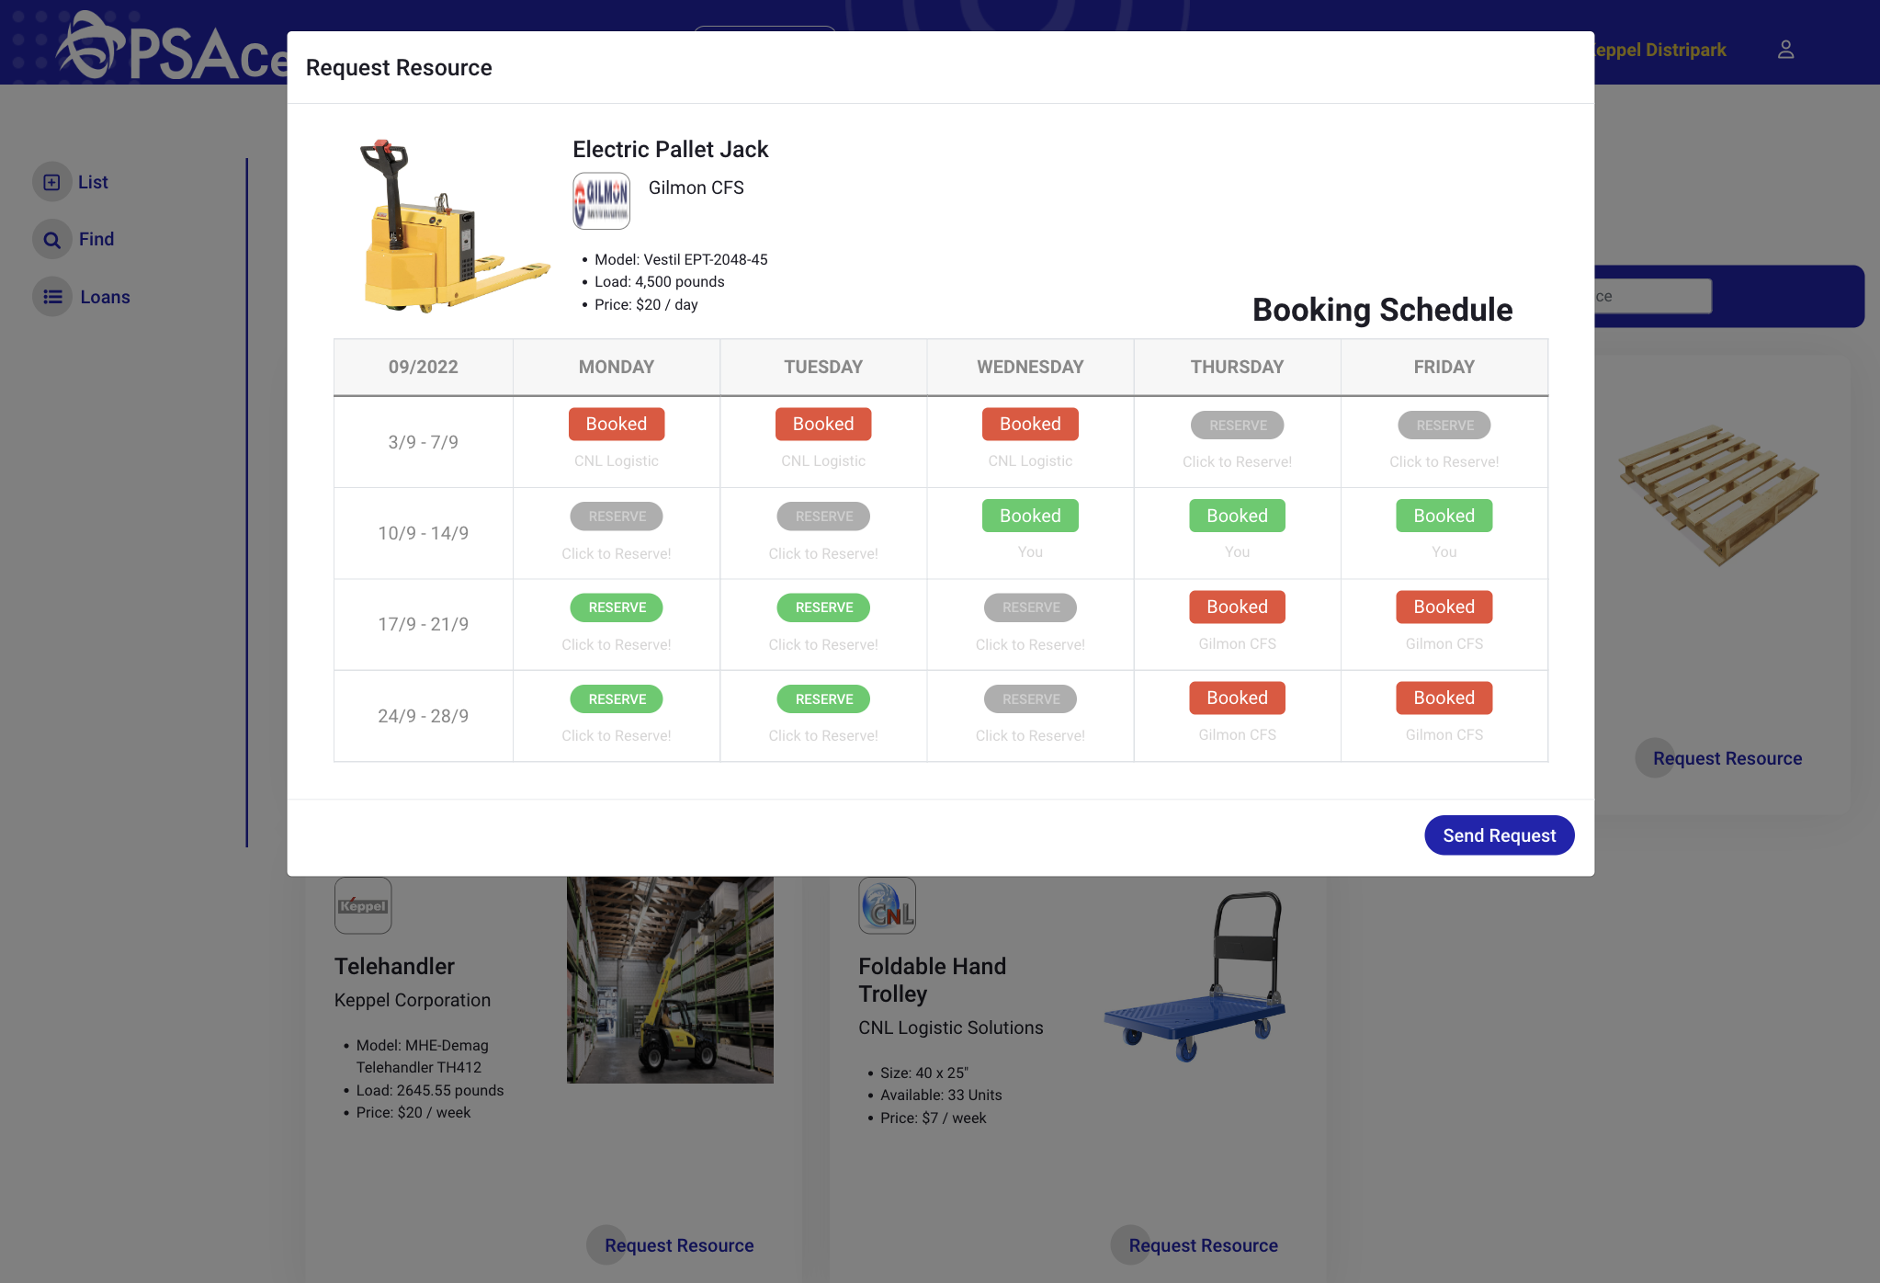
Appendix A: Resources Pages
Find
Notes:
FEATURE - SERVICES

Slide 16
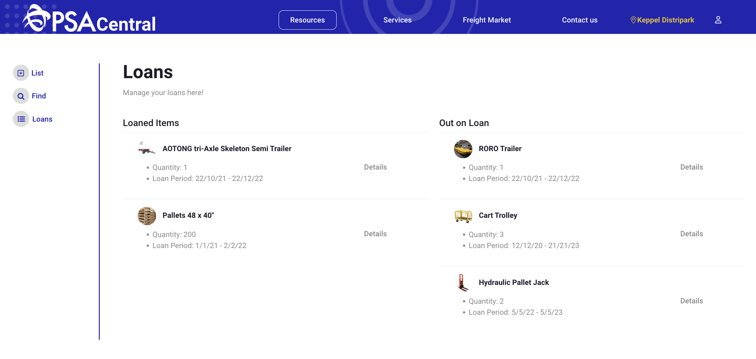
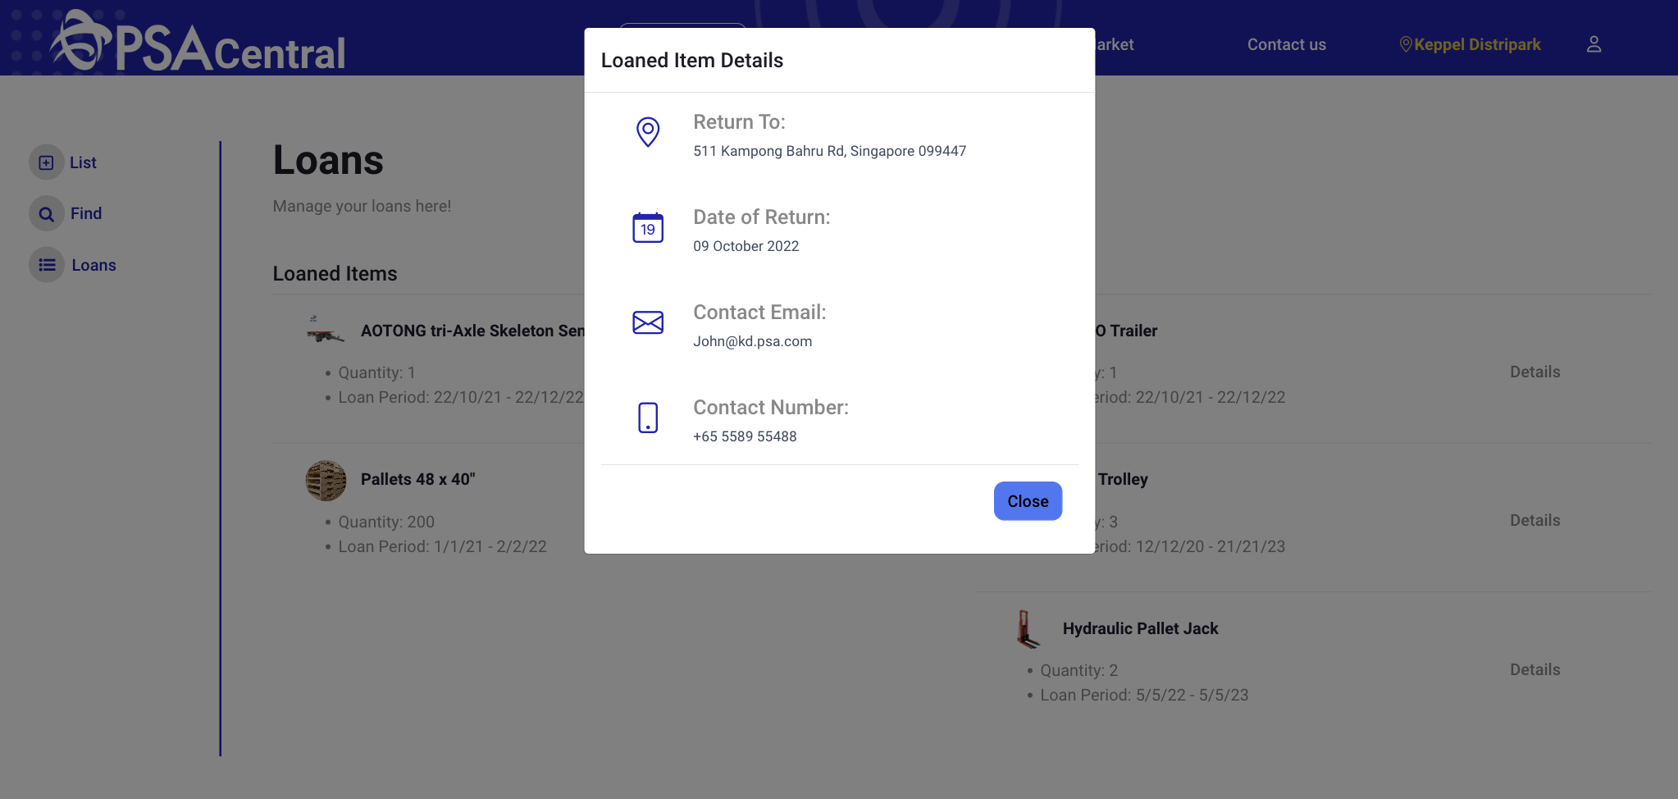
Appendix A: Resources Pages
Loan
Notes:
FEATURE - SERVICES

Slide 17
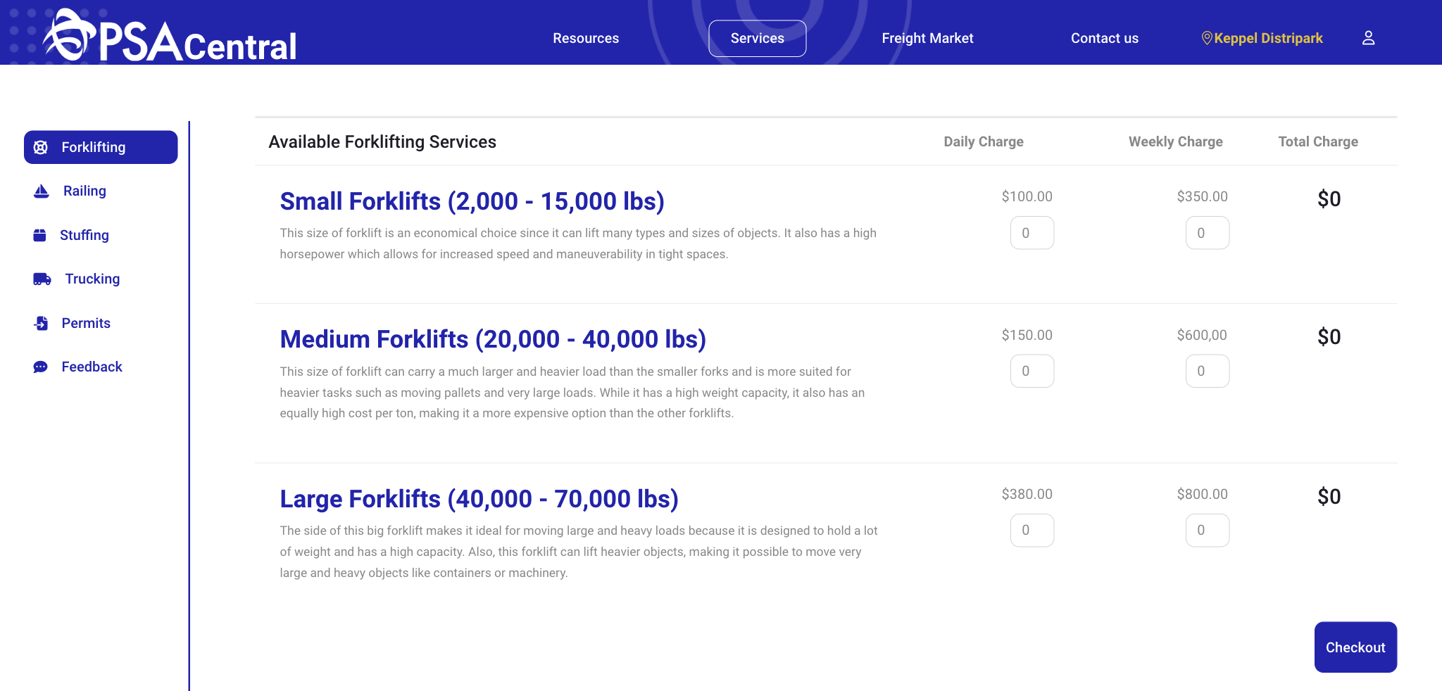
Appendix B: Services Pages
Forklifting
Notes:
FEATURE - SERVICES

Slide 18
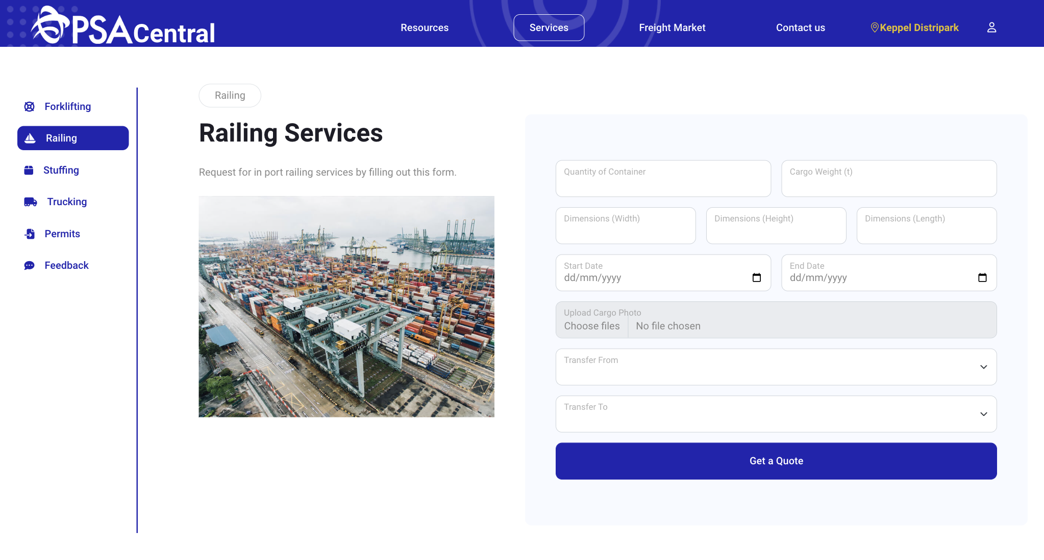
Appendix B: Services Pages
Railing
Notes:
FEATURE - SERVICES

Slide 19
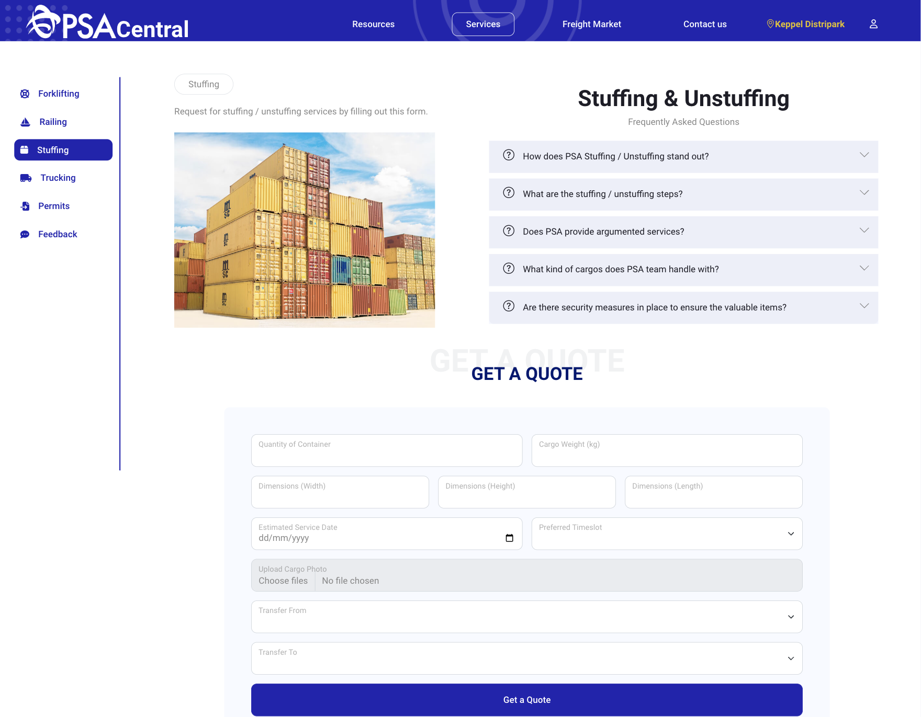
Appendix B: Services Pages
Stuffing
Notes:
FEATURE - SERVICES

Slide 20
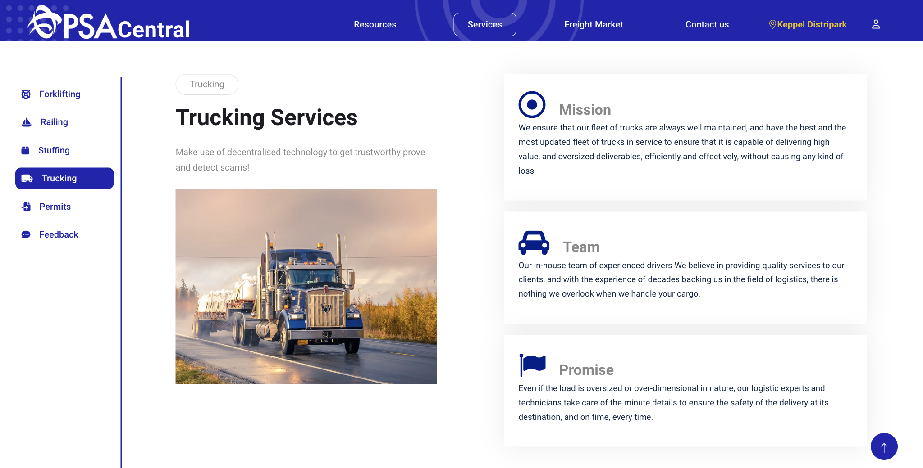
Appendix B: Services Pages
Trucking
Notes:
FEATURE - SERVICES

Slide 21
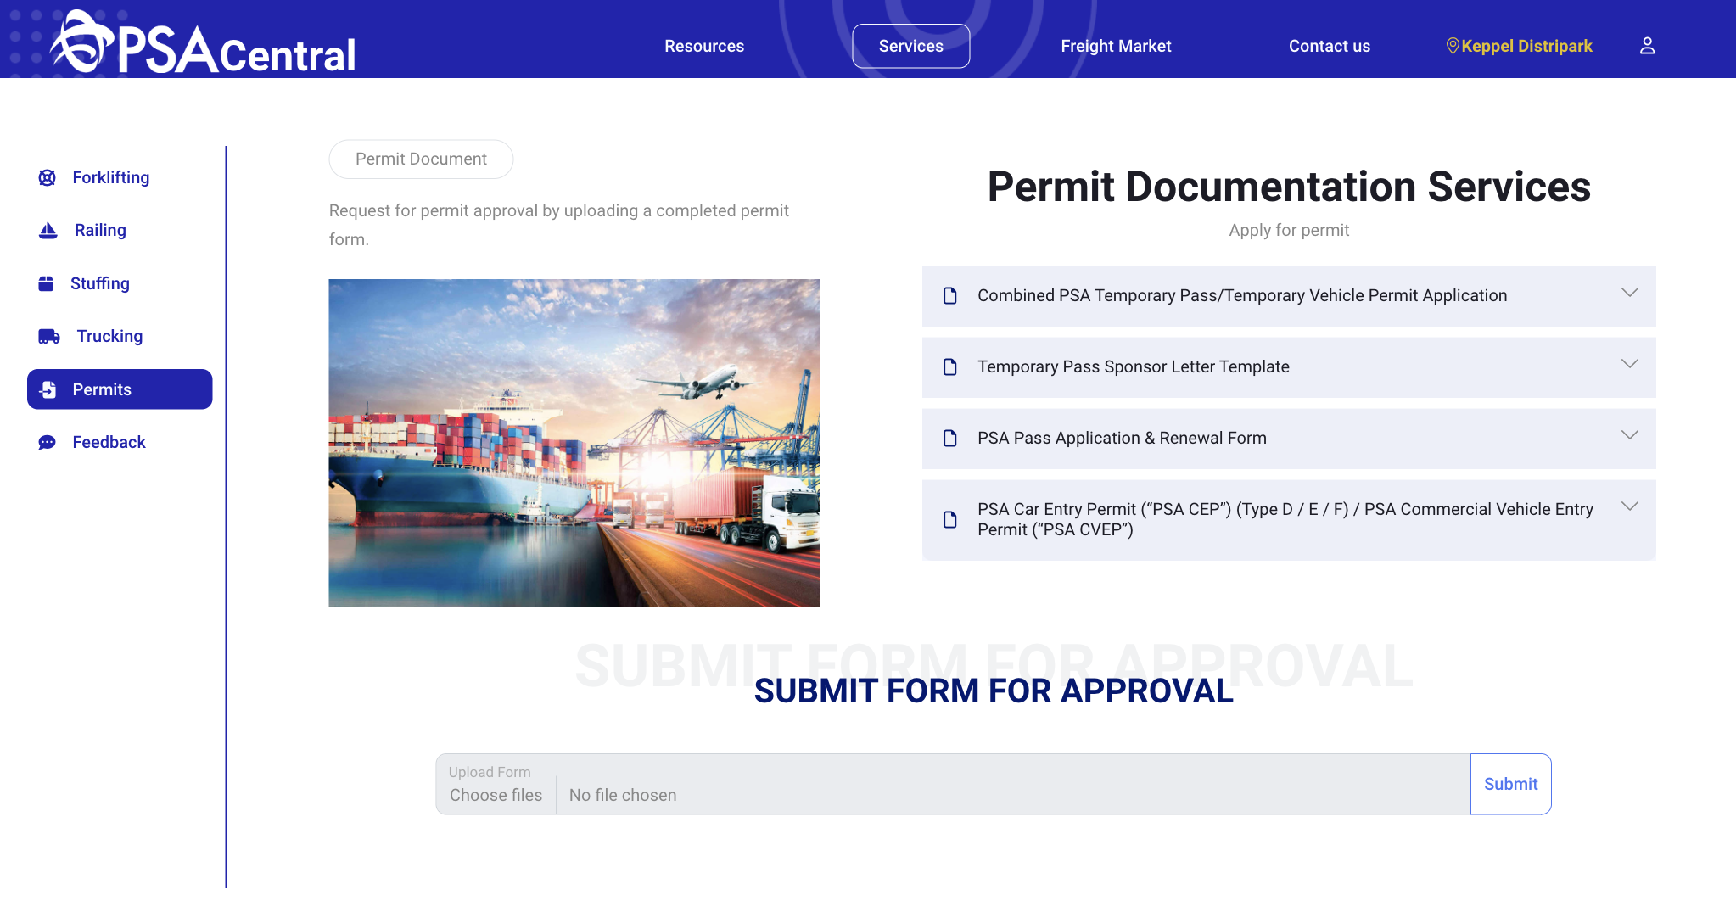
Appendix B: Services Pages
Permits
Notes:
FEATURE - SERVICES

Slide 22
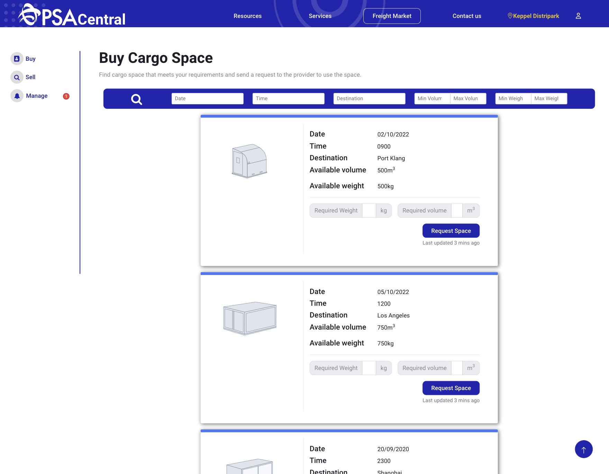
Appendix C: Freight Market
Buy
Notes:
FEATURE - SERVICES

Slide 23
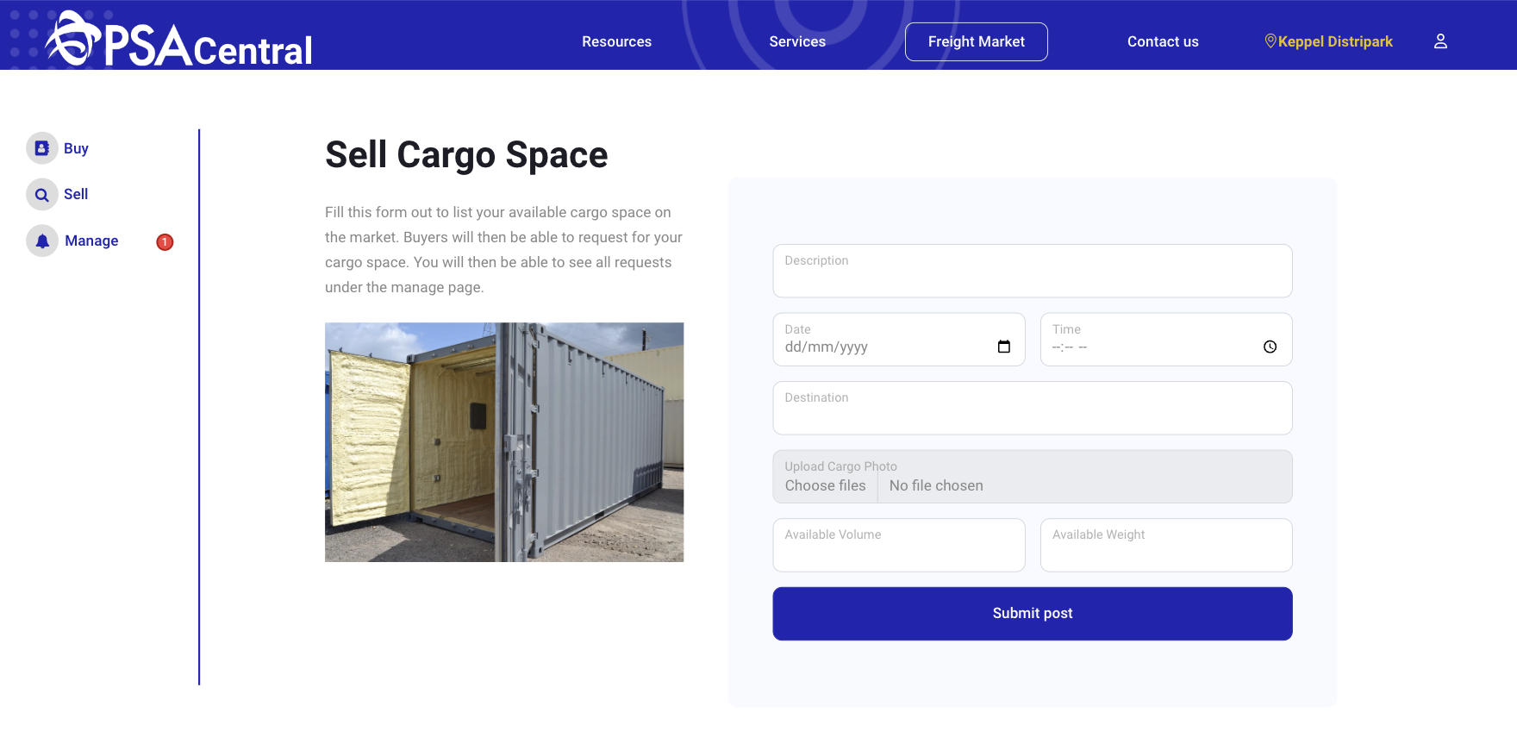
Appendix C: Freight Market
Sell
Notes:
FEATURE - SERVICES

Slide 24
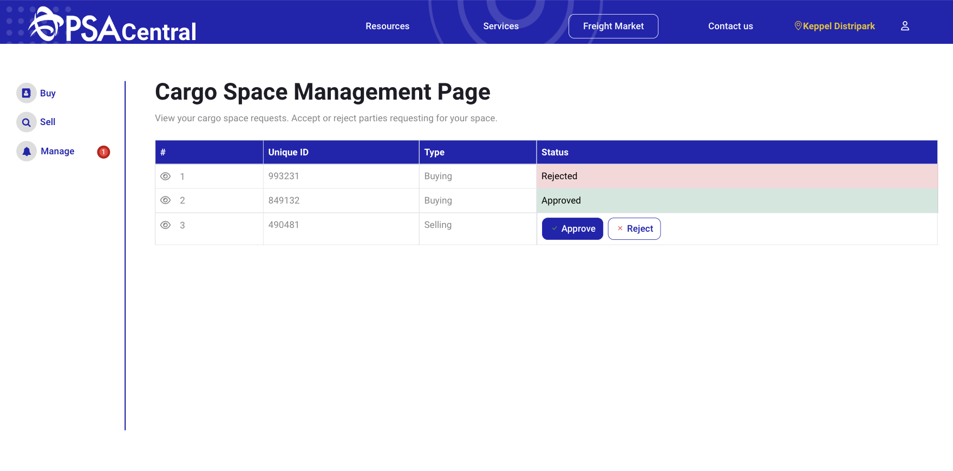
Appendix C: Freight Market
Manage
Notes:
FEATURE - SERVICES

